Slide 1
AQUATIC ECOSYSTEM
Tram, Kevin, Moon

Slide 2
What is aquatic ecosystem?
Aquatic ecosystems are systems composed of living organisms and non-living elements interacting in a watery environment. In simple terms, an aquatic ecosystem is a community of plants and animals that primarily depend on water.
Aquatic ecosystem is characterized by 4 factors:
Temperature
Sunlight depth
Oxygen concentration
Available nutrients

Slide 3
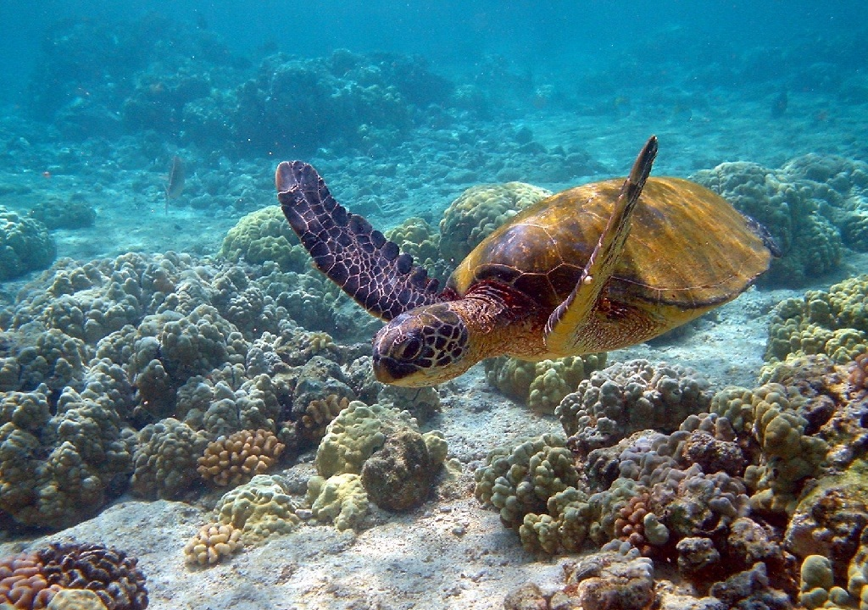
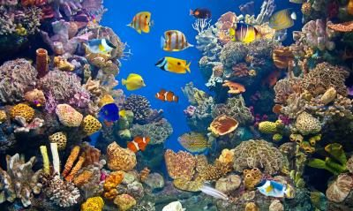

Slide 4
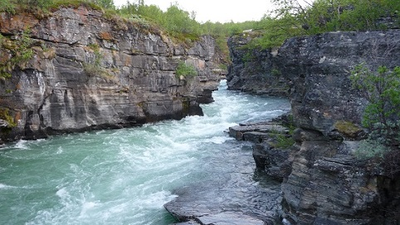
Types of aquatic ecosystems
Base on the salinity, we are classified into two main types of aquatic ecosystem.
Freshwater ecosystem ( = 0.5 ppt)
Marine ecosystem ( 30 - 50 ppt)

Slide 5
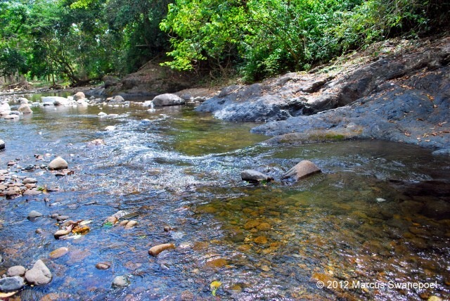
Freshwater ecosystem
Cover 0.8% of earth’s surface.
Approximately 41% of the earth’s fishes are found in freshwater ecosystems.
Example: Streams and rivers, lakes ponds and pools, wetlands.
are in danger because of the rapid extinction rates of several invertebrates and vertebrates, mainly because of overfishing and other activities that harm the ecosystem.

Slide 6
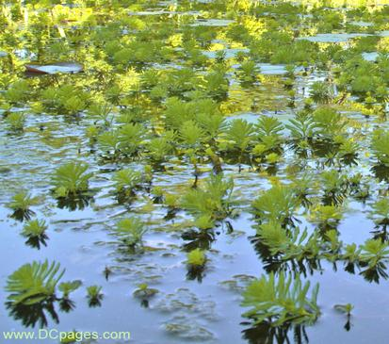
Species live in freshwater ecosystem:
Freshwater fish
Amphibians ( frogs)
Reptiles
Plants:
Cattails
Grasses
Trees

Slide 7
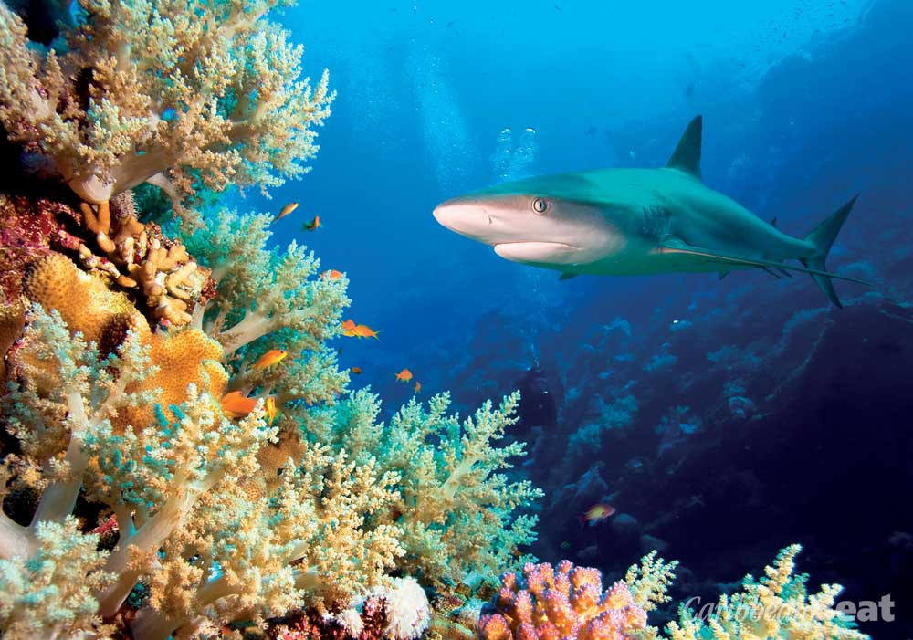
Marine ecosystem
Marine ecosystems cover approximately 71% of the earth’s surface. (largest)
Different habitats ranging from coral reefs to estuaries make up this largest aquatic ecosystem in the planet.
Example: Ocean, Intertidal zone and estuaries.

Slide 8
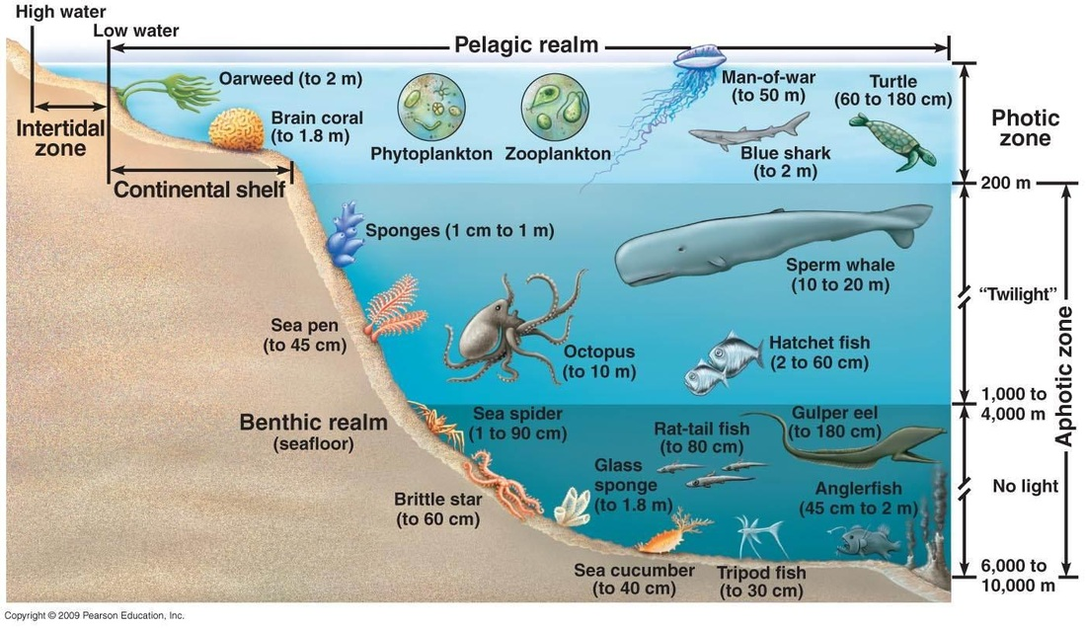

Slide 9
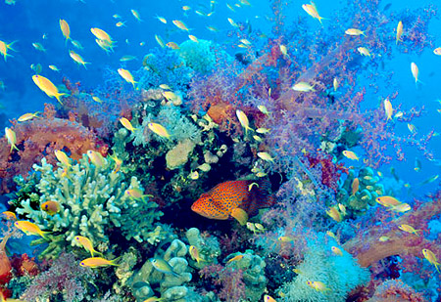
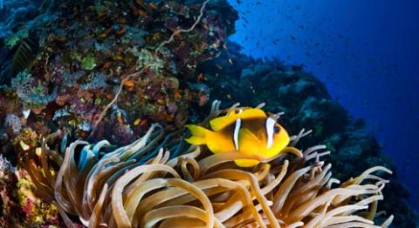
Species found in marine ecosystem:
Marine mammals such as seals, whales and manatees
Different species of fish including mackerel, flounder, dogfish, sea bass, etc.
Organisms such as the tiny planktonic, brown algae corals, echinoderms, etc.
Plants: Seaweed, kelp

Slide 10
https://www.youtube.com/watch?v=kL-9TB4qAho

Slide 11
QUESTIONS TIME
IF YOU DON’T KNOW JUST ASK US :))
P/s: Ask google first, ask us later

Slide 12
THE END

