Slide 1
BIODIVERSITY

Slide 2
What is biodiversity?
Biodiversity ( Biological Diversity) is the variety of all life forms: The different plants, animals and micro-organisms, their genes and the ecosystems of which they are a part.

Slide 3
Flora and Fauna depend on
Climate
Altitude
Soils
Presence of other species
Most of the biodiversity concentrated in Tropical region
Plants, Animals, and climate work together to maintain the balance of nature.

Slide 4
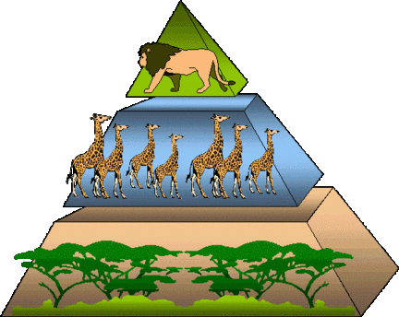
Pyramid of nature balance
Biodiversity is important for sustaining life on earth because it prevent any one species from throwing the balance of nature out of order.

Slide 5
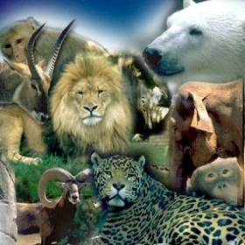
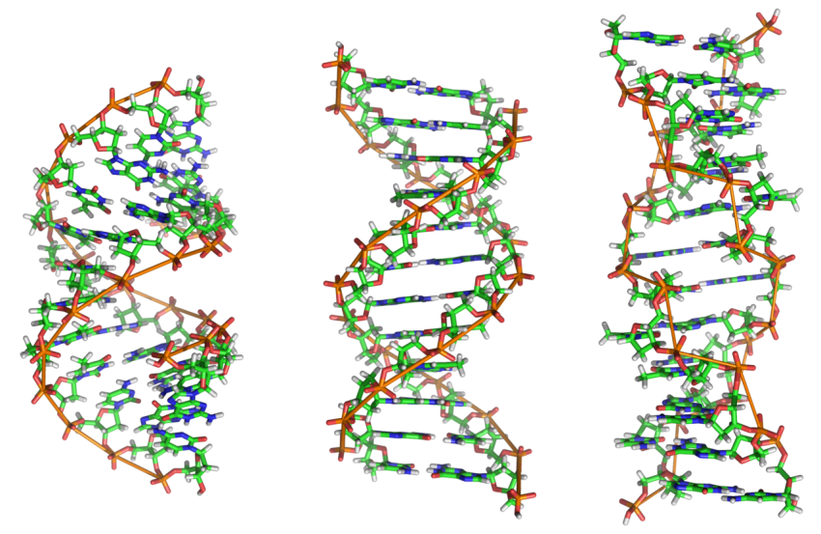
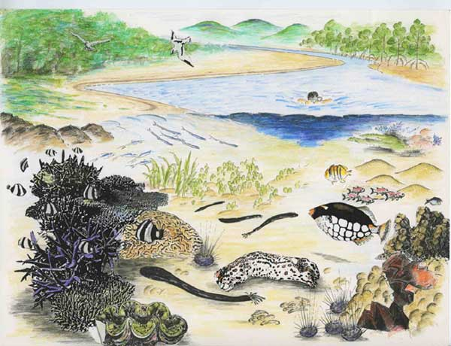
There are 3 types of biodiversity
Species Diversity
Genetic Diversity
Ecosystem Diversity

Slide 6
Species diversity
all the species on Earth from single organisms to plants to the largest mammals.

Slide 7
What makes a species diversity?
+ Morphology- organisms that look similar to each other are members of the same species.
+ Biological- when organisms can reproduce with members of a group to make viable offspring that can also reproduce.

Slide 8
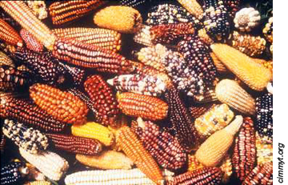
Genetic diversity
the genetic differences within species among populations and populations located in different locations.

Slide 9
What make up genetic diversity?
+ Populations- a group which mates together and has offspring.
+Individuals- individuals within populations have slightly different genes.
+ Genes- These different genes are known as alleles.

Slide 10
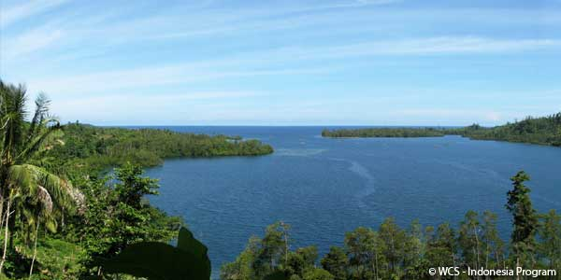
Ecological/Ecosystem Diversity
communities of different species and how they live with the chemical and physical environment.

Slide 11
What makes up ecosystem diversity?
Ecosystems are how a community and its members interact with biotic and abiotic items.

Slide 12
https://www.youtube.com/watch?v=aqtdaIkxnQo

Slide 13
Any questions?

Slide 14
THANKS!

